Slide 1
PHP File handling
The fopen() function is used to open files in PHP.
If the fopen() function is unable to open the specified file, it returns 0 (false).
The first parameter of this function contains the name of the file to be opened and the second parameter specifies in which mode the file should be opened:

Slide 2
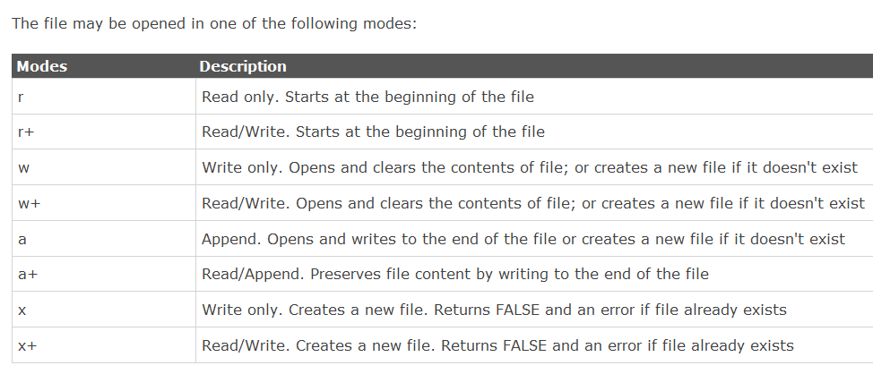

Slide 3
test1.php
Closing a file
<?php $file = fopen("test.txt","r"); //some code to be executed fclose($file); ?>

Slide 4
Check End-of-file
The feof() function checks if the "end-of-file" (EOF) has been reached.
The feof() function is useful for looping through data of unknown length.
Note: You cannot read from files opened in w, a, and x mode!
if (feof($file)) echo "End of file";

Slide 5
Reading a File Line by Line
The fgets() function is used to read a single line from a file.
Note: After a call to this function the file pointer has moved to the next line.
test2.php

Slide 6
Reading a File Character by Character
The fgetc() function is used to read a single character from a file.
Note: After a call to this function the file pointer moves to the next character.
test3.php

Slide 7
File upload
With PHP, it is possible to upload files to the server.
Create an Upload-File Form
To allow users to upload files from a form can be very useful.
Look at the following HTML form for uploading files:

Slide 8
<html> <body> <form action="upload_file.php" method="post" enctype="multipart/form-data"> <label for="file">Filename:</label> <input type="file" name="file" id="file"><br> <input type="submit" name="submit" value="Submit"> </form> </body> </html>

Slide 9
Notice the following about the HTML form above:
The enctype attribute of the <form> tag specifies which content-type to use when submitting the form. "multipart/form-data" is used when a form requires binary data, like the contents of a file, to be uploaded
The type="file" attribute of the <input> tag specifies that the input should be processed as a file. For example, when viewed in a browser, there will be a browse-button next to the input field
Note: Allowing users to upload files is a big security risk. Only permit trusted users to perform file uploads.

Slide 10
Create The Upload Script – upload_file.php
<?php if ($_FILES["file"]["error"] > 0) { echo "Error: " . $_FILES["file"]["error"] . "<br>"; } else { echo "Upload: " . $_FILES["file"]["name"] . "<br>"; echo "Type: " . $_FILES["file"]["type"] . "<br>"; echo "Size: " . ($_FILES["file"]["size"] / 1024) . " kB<br>"; echo "Stored in: " . $_FILES["file"]["tmp_name"]; } ?>

Slide 11
By using the global PHP $_FILES array you can upload files from a client computer to the remote server.
The first parameter is the form's input name and the second index can be either "name", "type", "size", "tmp_name" or "error". Like this:
$_FILES["file"]["name"] - the name of the uploaded file
$_FILES["file"]["type"] - the type of the uploaded file
$_FILES["file"]["size"] - the size in bytes of the uploaded file
$_FILES["file"]["tmp_name"] - the name of the temporary copy of the file stored on the server
$_FILES["file"]["error"] - the error code resulting from the file upload
This is a very simple way of uploading files. For security reasons, you should add restrictions on what the user is allowed to upload.

Slide 12
Restrictions on upload
one/two.html - Upload_file.php
Saving the Uploaded File
The examples above create a temporary copy of the uploaded files in the PHP temp folder on the server.
The temporary copied files disappears when the script ends. To store the uploaded file we need to copy it to a different location: test5.php

